Slide 1

Digital portfolio
STUDENT NAME: Abishek M
REGISTER NO : 212402321
NM ID: 16462936FC48391A36E4A7CEA3A5AC72
DEPARTMENT: BCA
COLLEGE: AGURCHAND MANMULL JAIN COLLEGE

Slide 2
PROJECT TITLE
Interactive Digital Portfolio using Front-End Development

Slide 3
AGENDA:
Problem Statement
Project Overview
End Users
Tools and Technologies
Portfolio design and Layout
Features and Functionality
Results and Screenshots
Conclusion
Github Link

Slide 4
Problem Statement
Traditional resumes and static portfolios often fail to capture attention or showcase an individual’s skills effectively. They lack interactivity, modern design, and user engagement, making it difficult for candidates to stand out in competitive environments.
To address this, the project focuses on building an Interactive Digital Portfolio using HTML, CSS, and JavaScript. This portfolio is not just visually appealing but also responsive, interactive, and structured in a way that highlights personal skills, projects, and achievements in a professional manner.

Slide 5
Project Overview
This project involves designing and developing a dynamic, user-friendly portfolio website that includes sections such as About, Skills, Projects, and Contact. Built entirely with front-end technologies, the portfolio ensures smooth navigation, interactive UI components, and modern layouts.
The main goal is to:
Create a digital identity for students, job seekers, and professionals.
Provide recruiters and employers with an easy way to evaluate skills.
Encourage networking and learning among peers and educators.

Slide 6

End Users
1
2
3
Students & Job Seekers
Recruiters & Employers
Educators & Peers
Present their skills, academic projects, and achievements in a professional manner to impress recruiters.
Quickly review candidate portfolios to assess technical knowledge, creativity, and design sense.
Use the portfolio as a learning resource, reference, or tool for collaboration and networking.
4
Freelancers & Professionals
Present their work to potential clients or collaborators.

Slide 7
Tools and Technologies
Tools:
Techniques:
HTML5 – Structures the content of the web pages.
Flexbox and Grid Layouts – To build modern, responsive, and structured page layouts.
CSS3 – Provides styling, design, responsiveness, and visual appeal.
Form Handling – Enables a functional and secure contact section.
JavaScript – Adds interactivity, smooth transitions, and dynamic elements.
Smooth Navigation & Animations – Enhances user experience and keeps visitors engaged.
Code Editors (VS Code / CodePen) – Used for writing, debugging, and managing code efficiently.
Version Control (Git) – For managing code versions and hosting the portfolio online.

Slide 8
Portfolio Design and Layout
The portfolio consists of five main sections:
01
02
03
Header & Navigation Bar
Home Section
About Section
Quick access to all sections (“Home, About, Skills, Projects, Contact”).
Includes an introduction, name, tagline, and banner.
Highlights academic background, technical skills, and strengths.
04
05
06
Projects Section
Contact Section
Resume Section
Displays sample projects in a grid format with descriptions, technologies used, and outcomes.
Provides a functional form and clickable social media links(Linkedin, Discord)
Provides a downloadable PDF resume and highlights key qualifications in a traditional format.

Slide 9










Features and Functionality
Navigation Bar
Interactive User Interface
Contact Form
Ensures seamless switching between sections.
Hover effects, transitions, and smooth scrolling for a modern feel.
Allows direct communication with recruiters, educators, or peers.
Responsive Design
Showcasing Projects
Works efficiently on desktops, tablets, and mobile devices.
Displays real work in an organized and professional way.

Slide 10
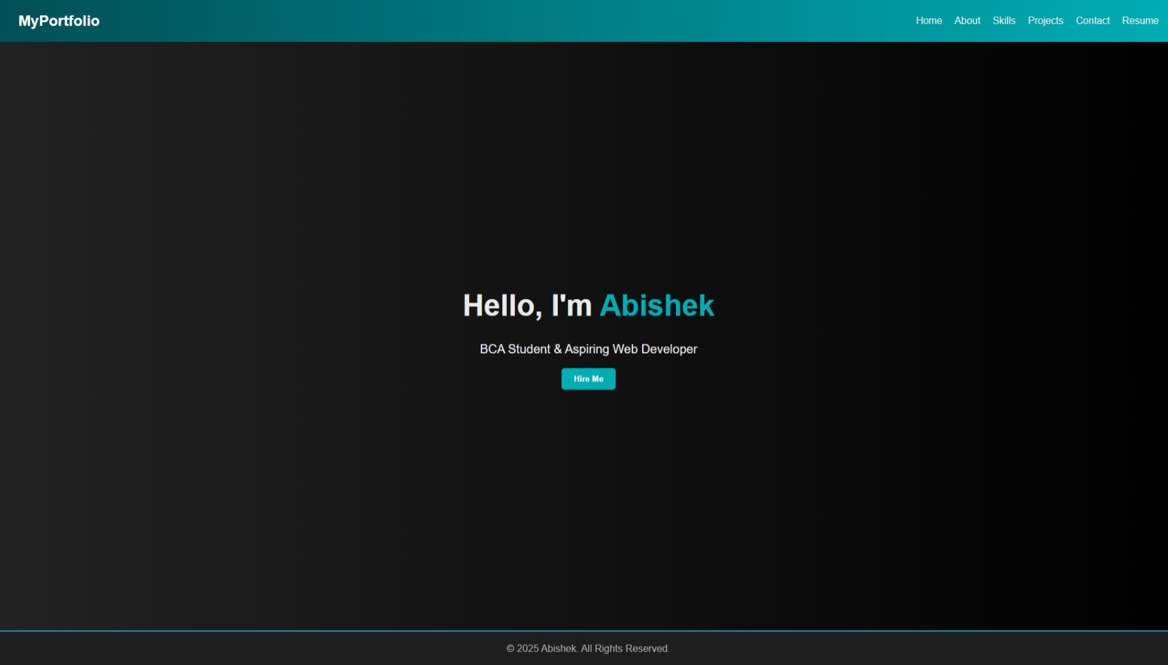
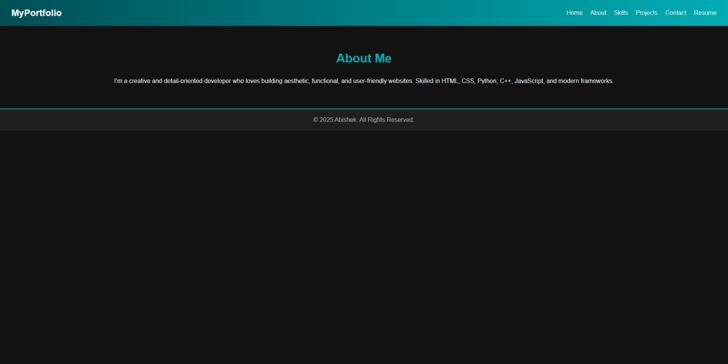
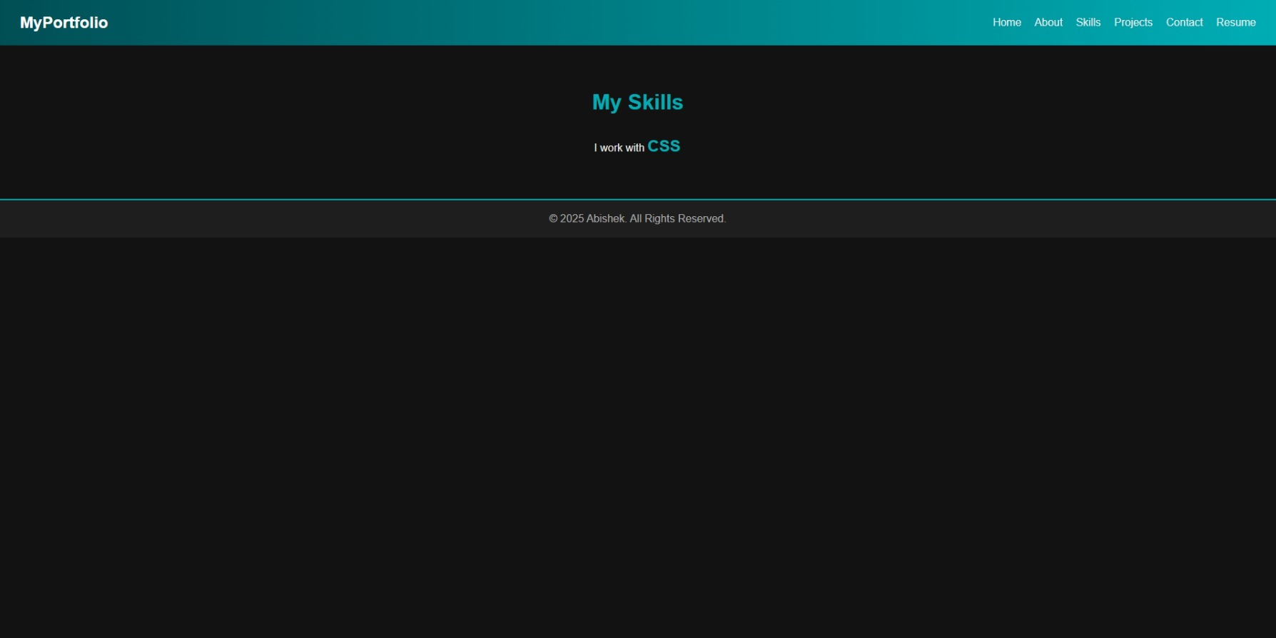
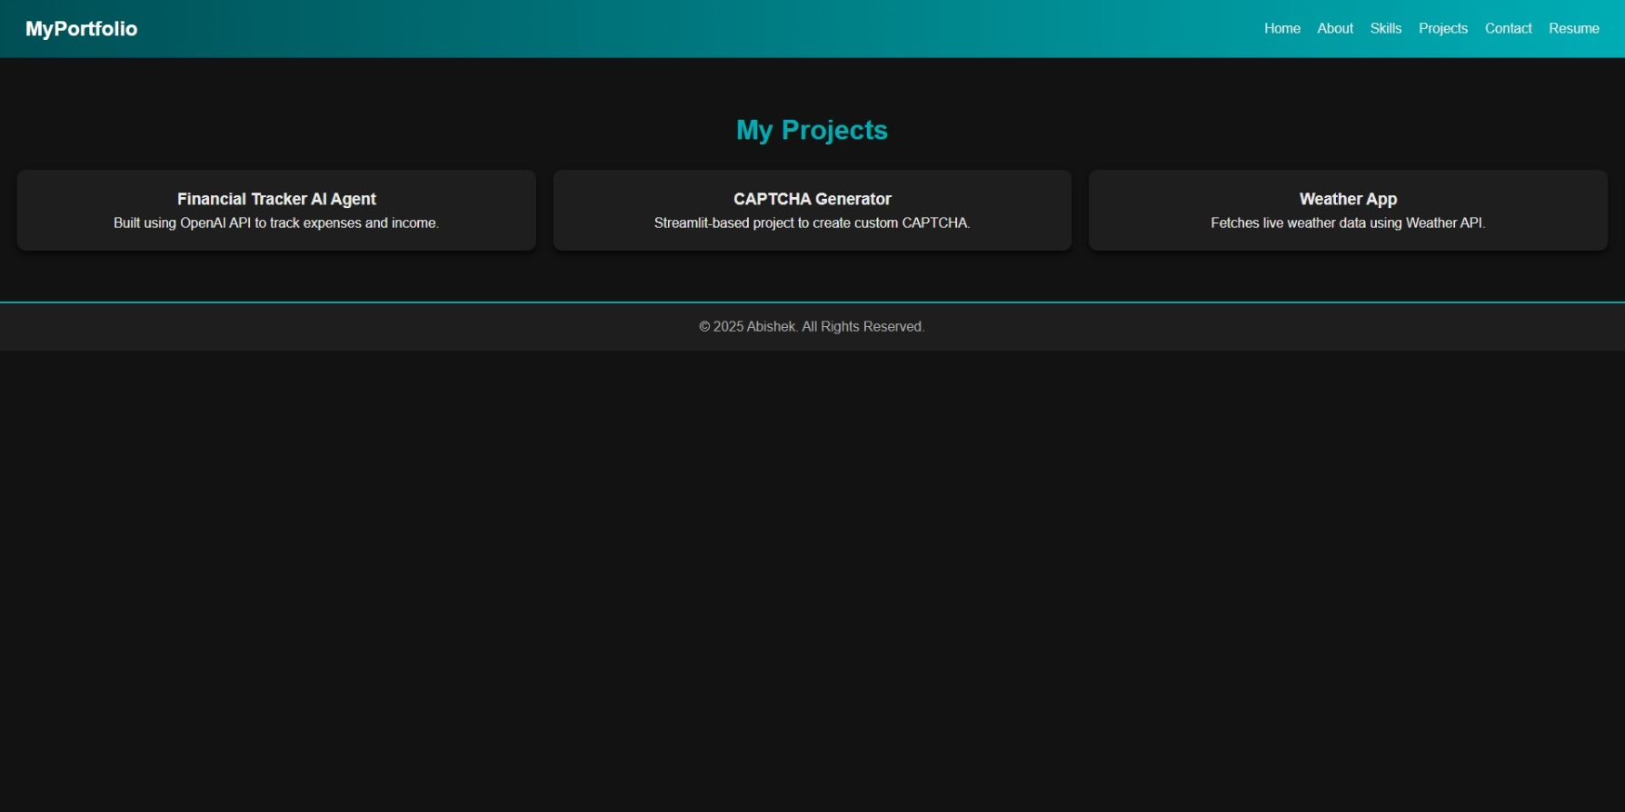
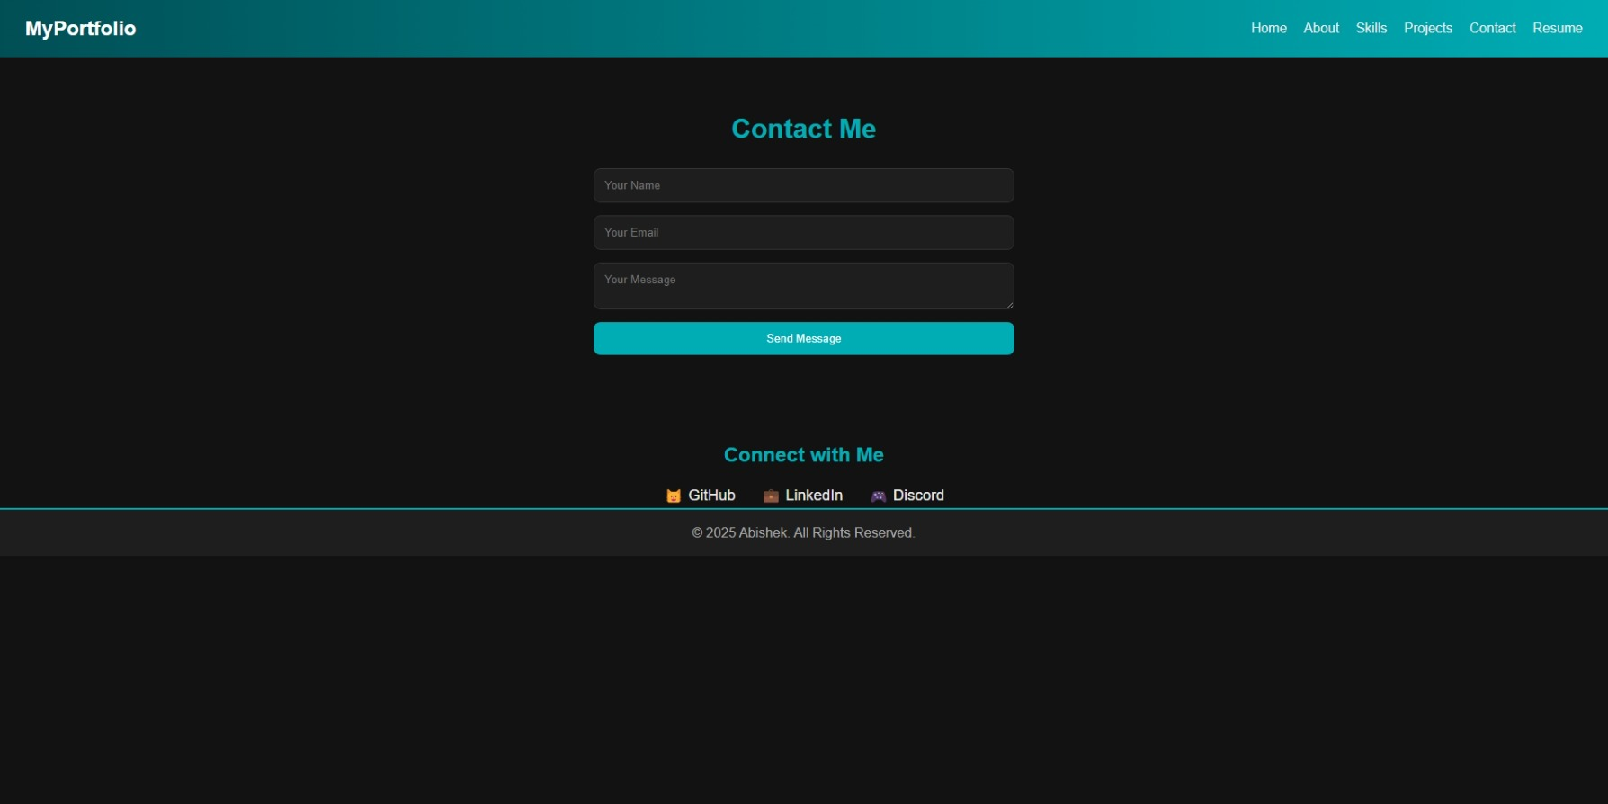
Results and Screenshots

Slide 11
Conclusion
The project “Interactive Digital Portfolio using Front-End Development” demonstrates how HTML, CSS, and JavaScript can be combined to build a professional, modern, and interactive portfolio. It helps individuals stand out in today’s digital world by offering recruiters and employers a clear, engaging, and well-structured representation of their capabilities.
This approach is more impactful than traditional resumes, providing a stronger chance of career opportunities and professional growth.
GitHub Link
https://github.com/Abishek-0407/Myserver.git

